Slide 1
NCH School Certificate in
Philosophy
Photo by Natalia Y on Unsplash

Slide 2
The dawn of philosophy
Photo by Sebastien Gabriel on Unsplash
Notes:
Introduce the course using the scheme of work to explain the main areas and objectives.

Slide 3
“The first philosopher”
Thales of Miletus
Notes:
Introduce Thales, the first philosopher (so it is said!)

Slide 4
A good theory?
“Everything is water”
Photo by Imleedh Ali on Unsplash
Notes:
Is it a good theory?
On the one hand, Thales got it wrong (water is a molecule, not a fundamental particle)
On the other hand, it was a good idea to seek for a simple model of the physical world,, which could explain many diverse phenomena – essentially the start of the scientific method.

Slide 5
Keynotes
Western philosophy began in the 7th century BCE in Ancient Greece.
Notes:
Ask students to start a keynotes file and add these notes.

Slide 6
Keynotes
The earliest philosophers were called the
‘pre-Socratics’

Slide 7
Keynotes
Thales, said to be the first philosopher, rejected traditional Greek mystical ideas about the world.

Slide 8
Keynotes
Thales tried to understand the world using observation and reason.

Slide 9
Keynotes
Thales’ theory was that ‘everything is water’.

Slide 10
Research one pre-Socratic philosopher.
Introduce them to your group.
Photo by Imleedh Ali on Unsplash
Notes:
This can be a short research exercise.
The aim is to show what an interesting and quite wacky bunch the pre-Socratics were.
Also an opportunity to get students involved in group discussion.

Slide 11
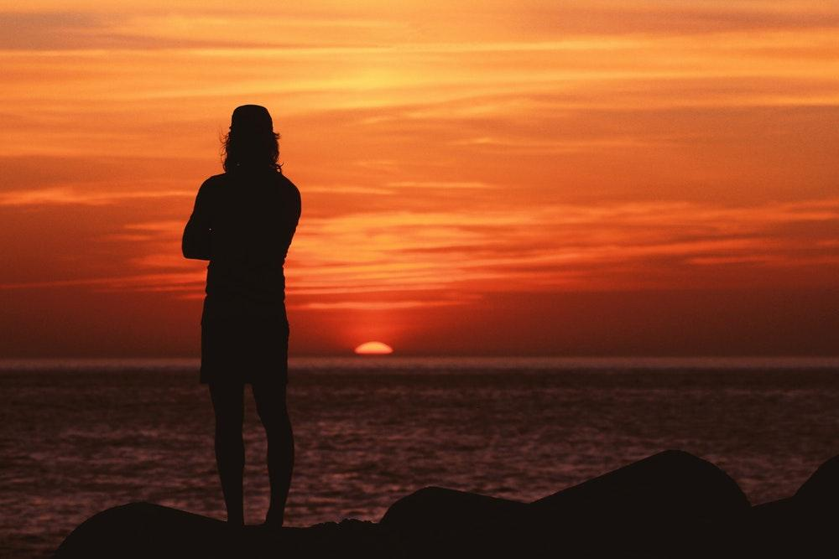
Searching for the good life: Socrates
Photo by Imleedh Ali on Unsplash
Notes:
With Socrates, the focus shifts from ‘what is the world made from?’ to ‘how should I live?’ (from metaphysics to ethics, if you want to use technical terms).

Slide 12
Introducing Socrates
Notes:
Sound quality not great but a very brief intro from me.

Slide 13
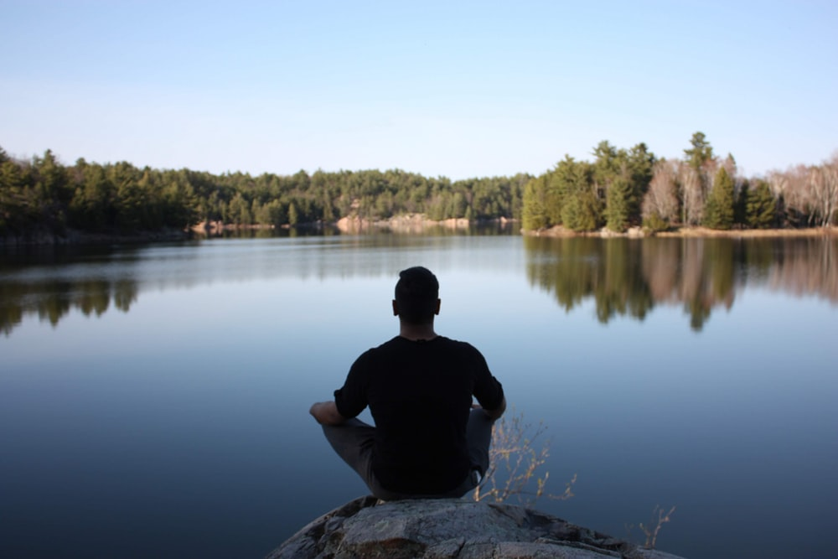
You cannot live a full human life without philosophy: true or false?
Photo by Shashaank Srinivasan on Unsplash
Notes:
Run as a think / pair / share or small group discussion with feedback.

Slide 14
Socrates: the man and his life
Notes:
A nice introduction to Socrates.

Slide 15
Keynotes
Socrates is held to be the ‘father of philosophy’.
Notes:
More notes for their keynote file.

Slide 16
Keynotes
The oracle prophesied that Socrates was the ‘wisest man of all’.

Slide 17
Keynotes
Socrates realized that he was wiser than all others, because he knew how little he knew.

Slide 18
Keynotes
Socrates enraged his fellow Athenians by critically questioning their ideas.

Slide 19
Keynotes
Socrates was convicted of denying the gods of the state and corrupting the youth, and executed in 399 BCE.

Slide 20
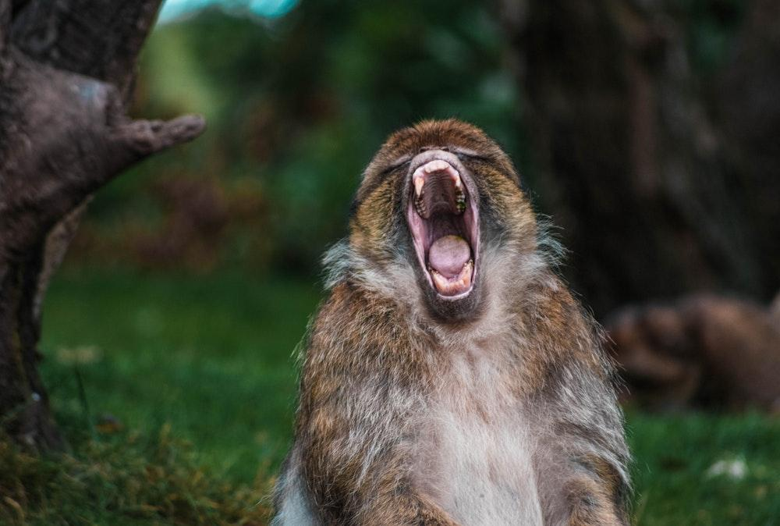
Right or Wrong? “Don’t criticize my beliefs”
Photo by Lewis Roberts on Unsplash
Notes:
Socrates was famous for introducing the method of Socratic questioning – rigorously challenging people to explain their ideas of courage, justice, knowledge or goodness.
Should we criticize the beliefs of others?
On the one hand, critical questioning is at the heart of the search for the truth (we use it in science, in the courts of law, in education, in government…)
On the other hand, it could be argued that Socrates death shows what happens if we persistently criticize others…
Run this as a group discussion with feedback.

Slide 21
The Ideas of Socrates
Notes:
There will probably not be time for this clip as well but if could be set as a homework exercise,.

Slide 22
Virtue or pleasure: which would you choose?
Photo by Oliver Roos on Unsplash
Notes:
Was Socrates a bit of a mug? He got on the Athenian’s nerves, got himself sentenced to death, and could have propsed a lesser punishment (or even walked out of the jail!).
Yet he chose to die for his belief in his calling as a philosopher.
He taught that we should choose the life of virtue over the life of pleasure.
Of course, often the two coincide.
But when they don’t – when it is unpleasant to do the right thing – how should we choose?
Should the pursuit of pleasure ever be allowed to trump the life of virtue?

Slide 23
What is real?
Photo by Aziz Acharki on Unsplash
Notes:
This works well as a discussion starter.

Slide 24
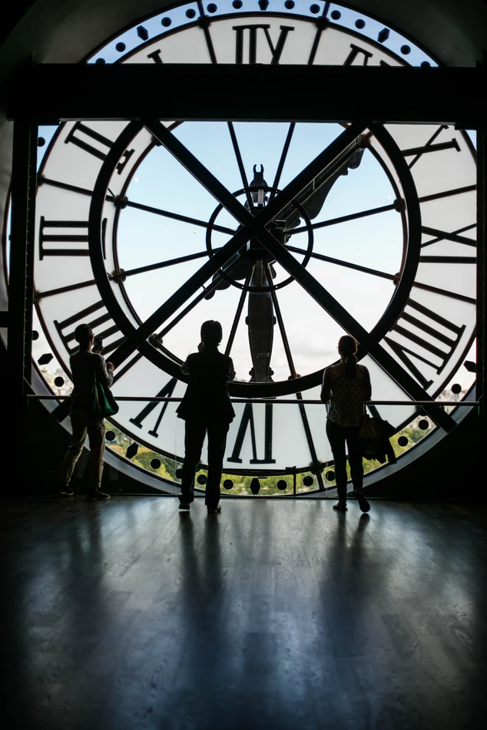
Is time real?
Photo by Erik Witsoe on Unsplash
Notes:
Some of these ‘what is real?’ questions can be run by posting the question on a discussion forum or Google Classroom question and asking students to type out their responses as part of a class discussion.

Slide 25
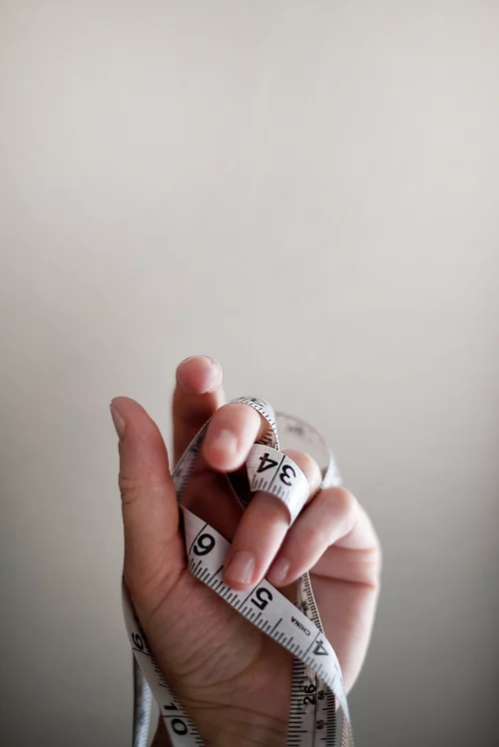
Are numbers real?
Photo by Jennifer Burk on Unsplash

Slide 26
Is the world of sense experience real?
Notes:
Likely to provoke lively discussion.

Slide 27
Is beauty real?
Photo by Meredith Whitman on Unsplash
Notes:
Students may agree that different people have different ideas, but does this imply the unreality of beauty, or does it mean it is real but personal?

Slide 28
Is truth real?
Photo by Steve Johnson on Unsplash
Notes:
We are now moving into the questions that bring us to Plato - the reality of beauty, truth and goodness.

Slide 29
Is goodness real?
Photo by Jenn Evelyn-Ann on Unsplash

Slide 30
Introducing Plato
(428 - 347) BCE
Notes:
A short intro to Plato, linking to Socrates.

Slide 31
Keynotes
Plato was a student of Socrates. He believed that the world of the senses is not reality.
Notes:
More notes for their keynote file.

Slide 32
Keynotes
Reality is made up of the Ideal Forms, things like Truth, Goodness and Beauty.
Notes:
More notes for their keynote file.

Slide 33
Keynotes
Philosophers should free themselves from the illusions around them and contemplate these pure Forms.
Notes:
More notes for their keynote file.

Slide 34
Plato’s Cave
Notes:
A great Ted Ted talk - leads nicely into debate about the ideal society. Was Plato right to think that philosophers have a better understanding of justice and therefore they should rule? If we accept that there are different ways to understand moral ideas, does this mean no one has the right to impose their views? Does this mean we should defend democracy against Plato’s criticisms?

Slide 35
What would your ideal society be like?
Photo by Luiz Felipe Souza on Unsplash
Notes:
This could be done by asking students to work in groups then post short written answers on a discussion forum or in Google Classroom class comments.

Slide 36
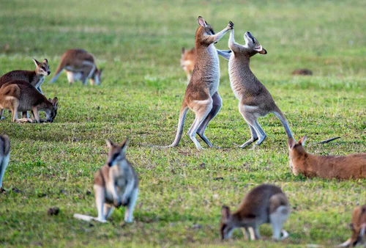
Debate
“We should let people believe their comfortable illusions.”
Photo by David Clode on Unsplash
Notes:
You could post this as a discussion starter and ask students to respond individually or in groups.

Slide 37
Aristotle:
How to live well
Photo by Tim Mossholder on Unsplash
Notes:
Aristotle, who lived between 384BCE and 322 BCE, thought about an enormous number of questions. One thing he believed was that things had purposes, and that to understand something, we had to know what it was for. He also wanted to know the secret of living well.

Slide 38
Introducing Aristotle

Slide 39
What makes people happy?
Photo by Ankush Minda on Unsplash
Notes:
Run a think pair share

Slide 40
What is art for?
Photo by Debby Hudson on Unsplash
Notes:
Run a think - pair - share

Slide 41
What makes someone a true friend?
Photo by Anthony Intraversato on Unsplash
Notes:
Explain that Aristotle thought friends were part of a good life. But what makes someone a true friend? Think - pair - share.

Slide 42
Aristotle

Slide 43
Keynotes
Aristotle believed that to understand something, we needed to know its purpose.

Slide 44
Keynotes
The way to be happy is to live a life of moral goodness.

Slide 45
Keynotes
True friends care about what is good for their friends.

Slide 46
Keynotes
The point of art is to make us desire what is good and fear what is bad.

Slide 47
How can I become good?
Photo by Hello I'm Nik on Unsplash

Slide 48
Aristotle and Virtue Theory

Slide 49
Does being good make you happy?
Photo by Matt Botsford on Unsplash
Notes:
Put this up as a question on a learning platform or discussion forum.
Run this as a mini-essay exercise.
Offer them a writing frame:
Introduction - explain the question
Arguments for the view that being good makes you happy (including examples)
Arguments against
Conclusion - resolve the debate
They can discuss in pairs then write up together.

Slide 50
Keynotes
For Aristotle, the good life is a life of virtue.

Slide 51
Keynotes
Virtues (good qualities) lie in between vices (bad qualities)

Slide 52
Keynotes
We become good by copying the actions of good people until they become part of our character.

Slide 53
What do we really know?
Photo by Dawid Zawiła on Unsplash

Slide 54
Can you trust your senses?

Slide 55
Rene Descartes

Slide 56
For discussion..
How do we know the difference between reality and illusion?
How do we know the difference between being awake and being asleep?
Do we know the world is real and we are not just parts of a computer simulation?

Slide 57
Keynotes
Descartes asked whether we could know that the physical world around us is real

Slide 58
Keynotes
Sceptics argue that we cannot know for certain that the world is not an illusion.

Slide 59
Are we living in a simulation?

Slide 60
If you could live in a perfect simulation, would you?

Slide 61
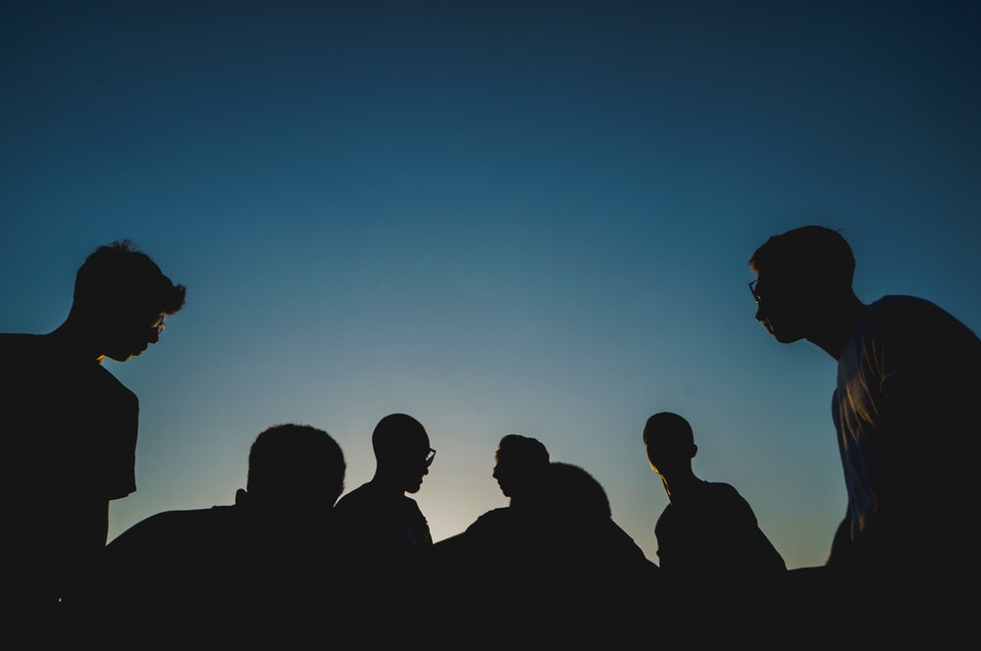
Where do you think knowledge comes from?
Can we ever be completely certain of anything?
Do we know that the world around us is real?
Would you prefer to live in an imperfect but real world or a perfect simulation?
Photo by Papaioannou Kostas on Unsplash
Notes:
These questions can be discussed in class then students can be asked to write a short response. A good way to do this is to post the questions as thread starters on a discussion forum or learning platform so that students can respond then engage with each other’s answers.

