Slide 1
School Certificate in Philosophy
Teacher Training – 18th November 2021

Slide 2
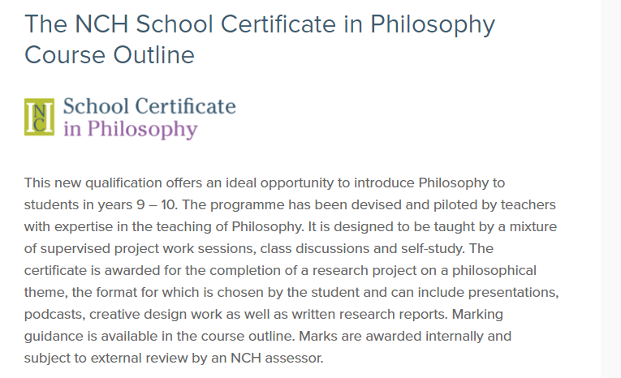

Slide 3
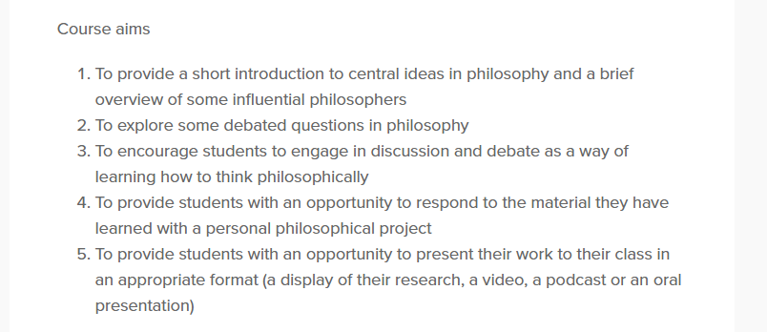

Slide 4
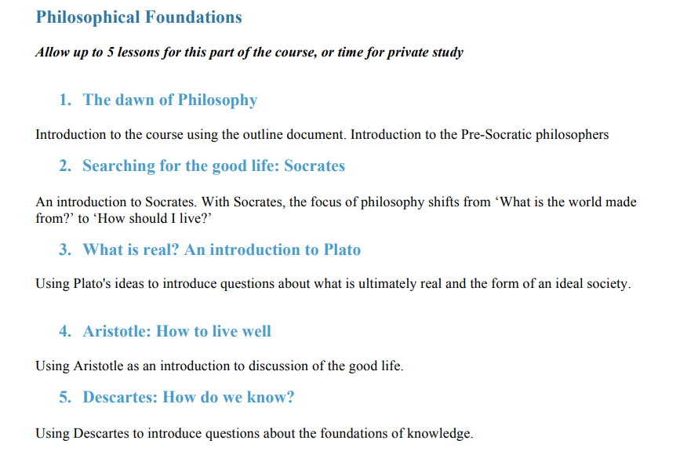

Slide 5
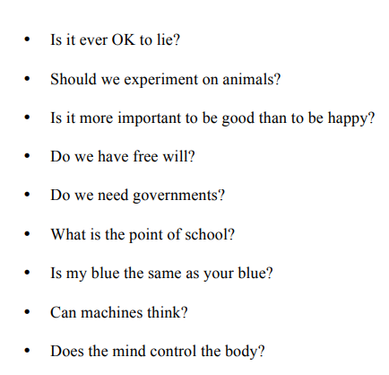
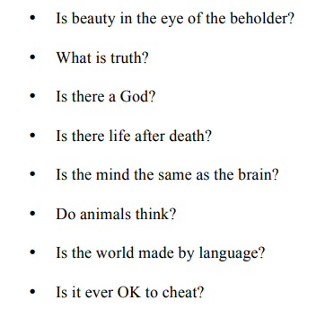
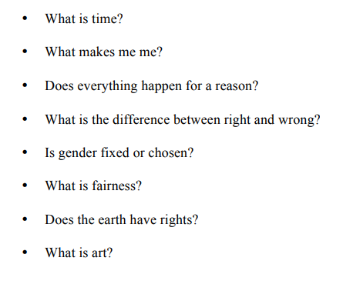

Slide 6
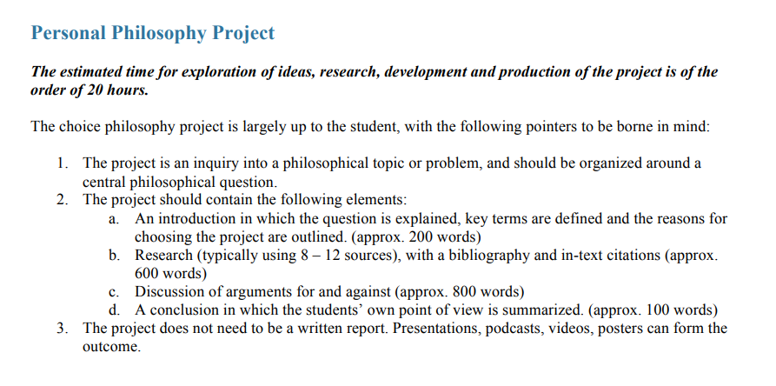

Slide 7
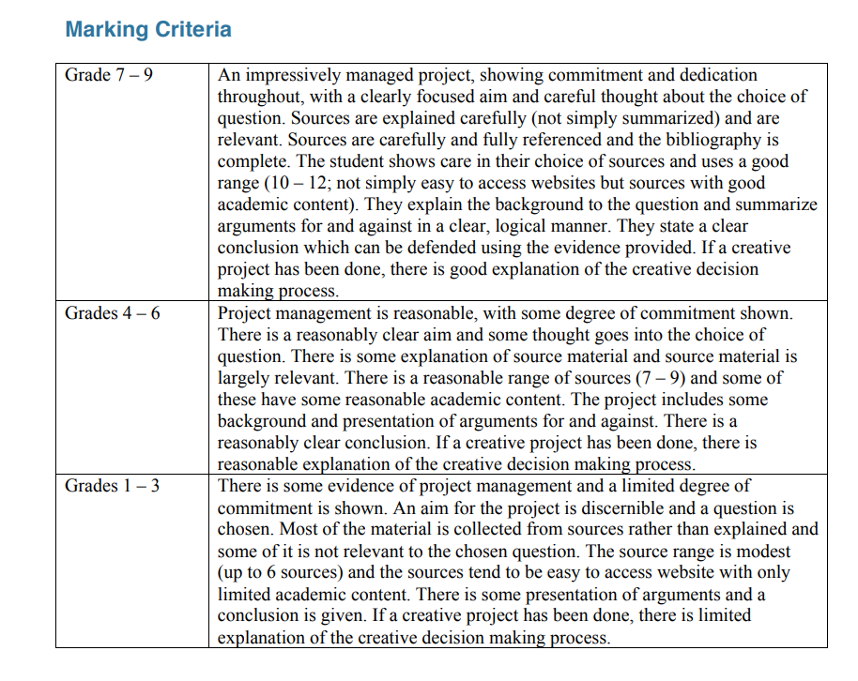

Slide 8
Teaching Points
Resource links here: https://www.nchlondon.ac.uk/study/school-certificate/course-resources/
Use the proforma for planning
Colour coding for group projects
Recommend a template (Introduction, Research, Discussion, Conclusion, Bibliography)
Teach research skills
Set targets
Use a shared document for commenting on progress
Encourage students to document progress with practical projects
Make use of digital tools (e.g. for automatic citations / bibliography building)
Encourage self-monitoring: https://www.nchlondon.ac.uk/wp-content/uploads/2020/02/SCHOOL-PHILOSOPHY-PROJECT-SELF-CHECK-LIST.pdf

Slide 9
Useful Links
Course Outline
https://www.nchlondon.ac.uk/study/school-certificate/course-outline/
Exemplar projects
https://www.nchlondon.ac.uk/study/school-certificate/exemplar/
Assessment guidance
https://www.nchlondon.ac.uk/study/school-certificate/assessment/
FAQs
https://www.nchlondon.ac.uk/study/school-certificate/faq/
Philosophy Short Course Playlist
https://www.youtube.com/playlist?list=PLJ__so98WtdU-cMgMQ6C0bJqWPx47AoL4

